Slide 1
Nuclear Fusion

Slide 2
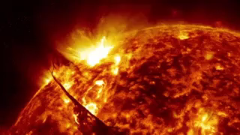
In this Smart Lesson you will learn to:
Define nuclear fusion.
Explain that more energy is released per nucleon in nuclear fusion then in nuclear fission because a greater percentage of the mass is transformed into energy.

Slide 3
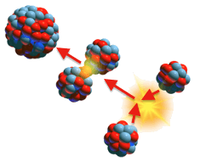
Nuclear fusion is the process of two nuclei joining together to make one larger nucleus.
It is defined as a nuclear reaction in which two or more atomic nuclei combine to form one or more different, heavier atomic nuclei and subatomic particles.

Slide 4
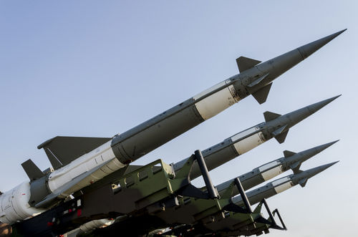
So where does nuclear fusion occur?
Fusion reactions generally only occur in stars, although they could occur anywhere in the universe for a very short time after the Big Bang. This is because of the large energy input required to initiate fusion reactions.
Research is being carried out into how to control a fusion reaction to generate energy.
Uncontrolled nuclear fusion is used in thermonuclear weapons (hydrogen bombs).

Slide 5
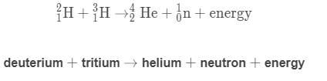
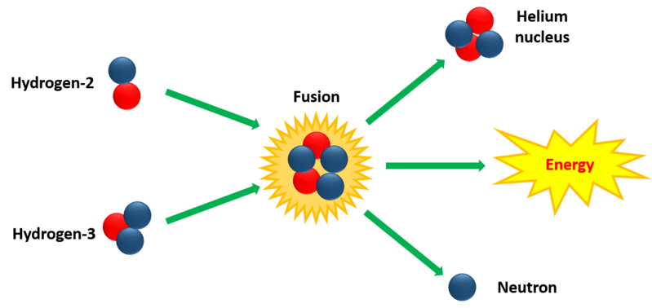
Unlike nuclear fission, which involves splitting large atoms, nuclear fusion involves fusing together small atoms such as hydrogen and helium.
For example:

Slide 6
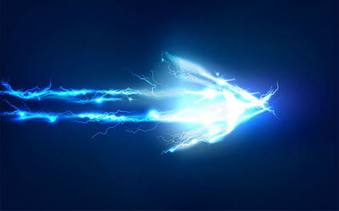
Energy from nuclear fusion.
The mass of the large nucleus is less than the combined masses of the two smaller nuclei. This is called the mass loss (Δm) and it is converted into energy.
We find the energy released by using the following formula:
ΔE=Δmc²

Slide 7
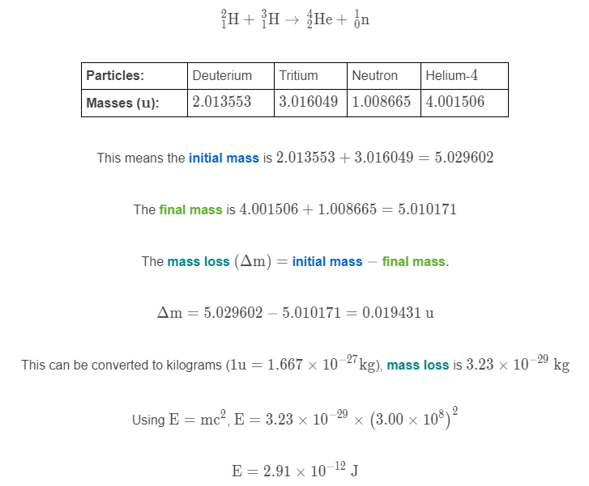
Worked example for calculating mass loss.
Consider the fusion of deuterium with tritium:

Slide 8
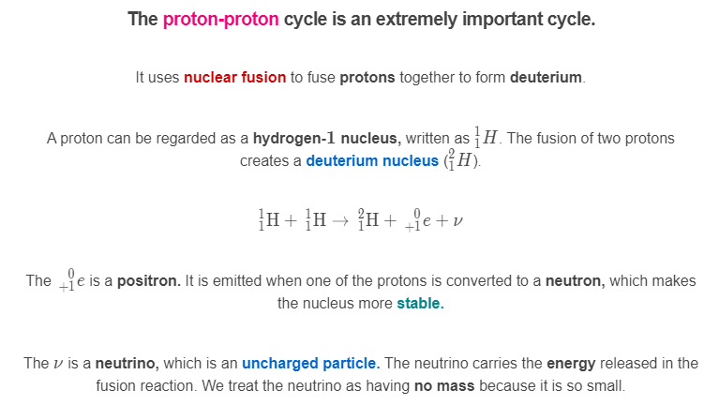

Slide 9

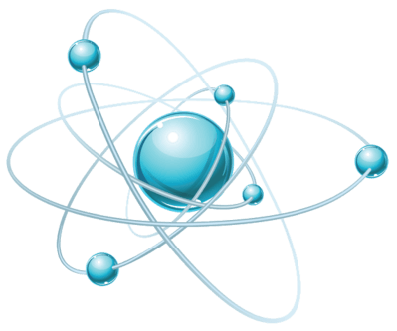
A fusion reaction can occur with deuterium and a proton to form helium-3.
Energy is released from this reaction through gamma rays (γ).
Deuterium already contains a neutron, so no positrons are emitted in this reaction

Slide 10
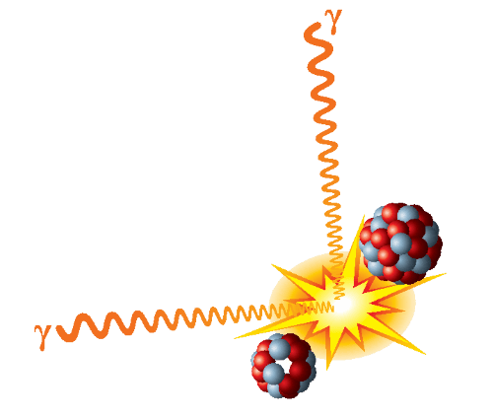
How does energy released by fusion compare to fission?
More energy is released per nucleon in nuclear fusion than in nuclear fission.
This is because a greater percentage of the mass is transformed into energy, as fusion works with much smaller atoms.

